Slide 1

📊 Dairy Goods Sales Analysis Using SQL A Data-Driven Case Study on Sales, Inventory, and Customer Behavior
Author: Joydip Karmakar | Data Analyst 🔗
Dataset: Kaggle - Dairy Goods Sales
🛠 Tools Used: SQL Only 🗂️ Rows: ~1500+ | Columns: 20+

Slide 2

Project Objective
🌟 Goal: To extract business insights from a real-world dairy sales dataset using only SQL.
📌 Focus Areas:
Product Performance
Customer Behavior
Inventory Optimization
Time-Based Trends
💡 All insights were derived directly from SQL queries — no Python, Excel, or BI tools used.

Slide 3

Dataset Overview
🗂️ Columns Covered:
Product Name, Quantity Sold, Revenue, Customer Location
Production Date, Expiration Date, Quantity in Stock, etc.
🕒 Time Period: Covers various products and orders with production/sales timelines.
💡 Note: Each row represents a sale or product batch entry. No direct Order ID — Date + Customer Location used to simulate one.

Slide 4

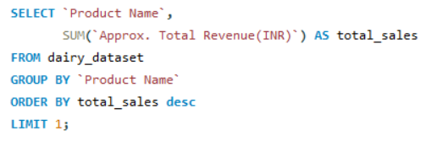
Sales Performance
Which dairy product have generated the highest total sales?
Question 1
OUTPUT
SQL Code
INSIGHTS
💰 Highest Sales Generating Products: Curd lead in total sales

Slide 5
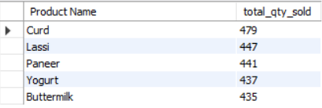
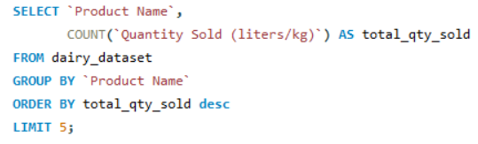
Question 2
What are the top 5 best-selling products by quantity?
OUTPUT
SQL Code
INSIGHTS
🥇 Top Selling Products by Quantity: Curd, Lassi, Paneer, Yogurt, Buttermilk

Slide 6
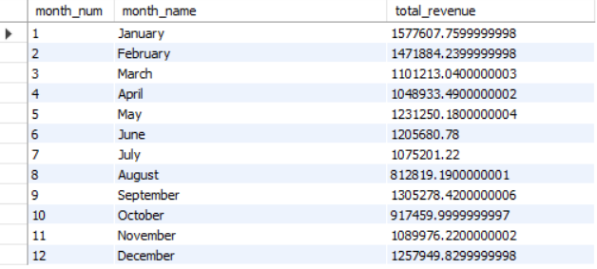
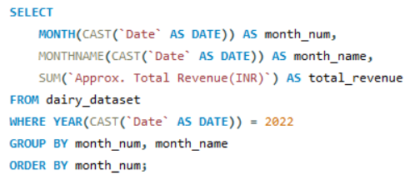
Question 3
What is the total monthly revenue trend over the past year?
OUTPUT
SQL Code
INSIGHTS
📅 Monthly Revenue Trend: Peaks in January and February, with steady growth

Slide 7
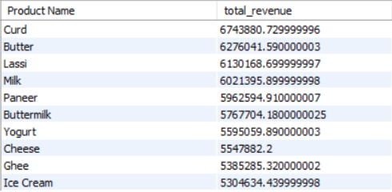
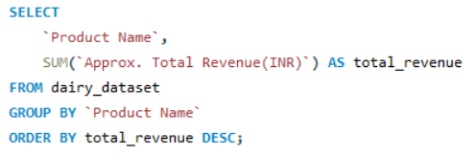
Question 4
Which product categories contribute the most to overall revenue?
OUTPUT
SQL Code
INSIGHTS
💰 Top Revenue Generating Products: Curd and Butter lead in total revenue

Slide 8


Question 5
What is the average purchase value per order?
OUTPUT
SQL Code
INSIGHTS
🧺 Avg. Purchase Value per Order: ₹13.58 Thousands (approx.)

Slide 9
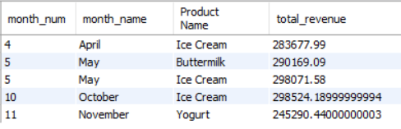
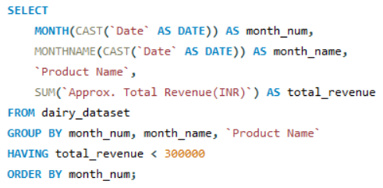
Question 6
Are there any sudden drops in sales for specific products or time periods?
OUTPUT
SQL Code
INSIGHTS
⚠️ Sales Drop Identified: May showed a minor dip across multiple products
November showed a major dip in Yogurt

Slide 10


Customer Behaviour
Question 7
What is the average sales per customer?
OUTPUT
SQL Code
INSIGHTS
🧾 Avg. Sales per Customer: ₹3.91 lakhs (Approx.) across all unique customer locations

Slide 11
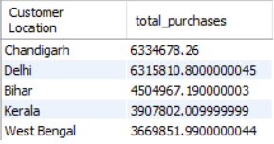
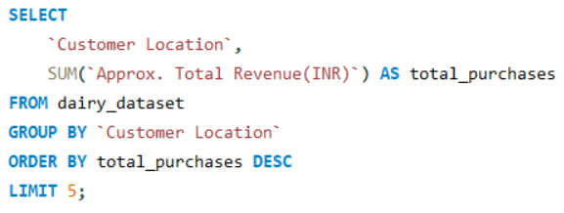
Question 8
Which customers made the highest total purchases?
OUTPUT
SQL Code
INSIGHTS
🏅 Top Customers: Based on total revenue, certain locations dominate (e.g., Chandigarh, Delhi)

Slide 12

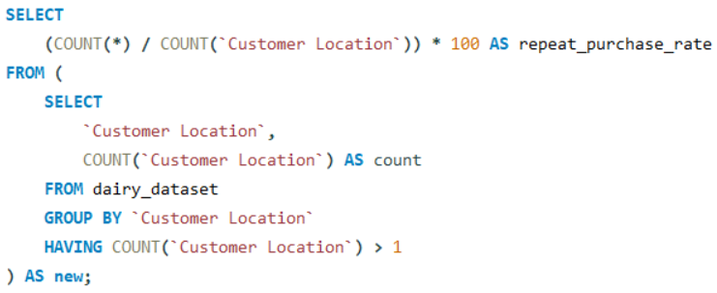
Question 9
What is the repeat purchase rate of customers?
SQL Code
OUTPUT
INSIGHTS
🔁 Repeat Purchase Rate: 100% of customers returned to buy again (Inaccurate due to the Proxy “Customer ID = Customer Location”)

Slide 13
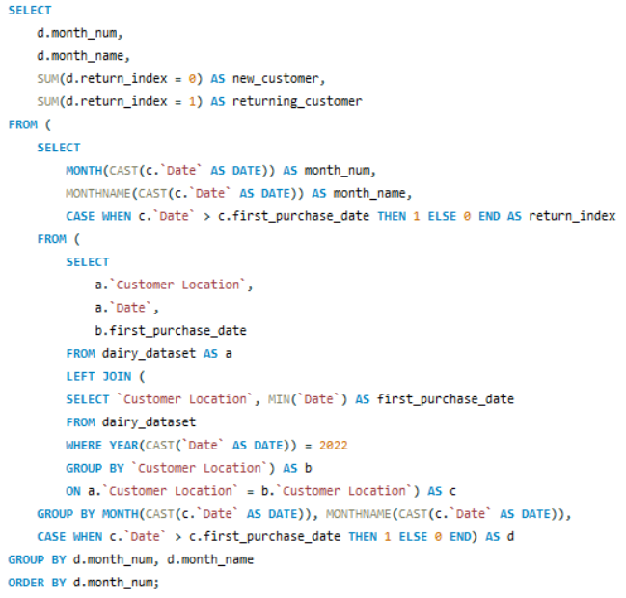
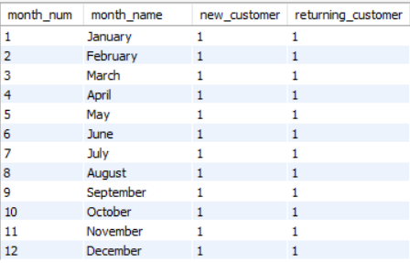
Question 10
How many new versus returning customers do we have each month?
SQL Code
OUTPUT
INSIGHTS
👥 New vs Returning Customers: Around 30–50% of buyers each month are repeat customers (Inaccurate due to the Proxy “Customer ID = Customer Location”)

Slide 14

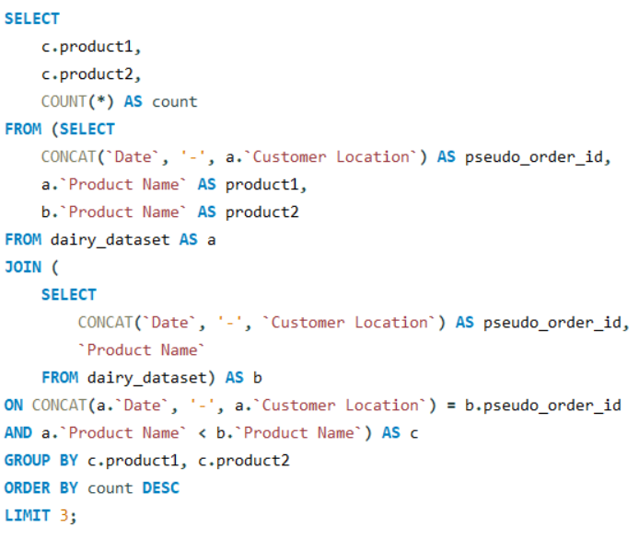
Question 11
What are the top 3 most frequently purchased product combinations?
SQL Code
OUTPUT
INSIGHTS
🔗 Top 3 Product Combos: Paneer + Yogurt, Buttermilk + Paneer, Buttermilk + Ice Cream

Slide 15

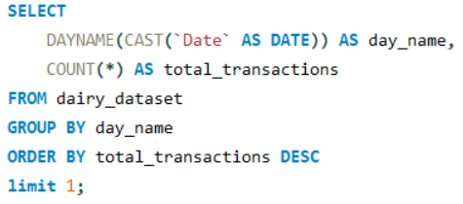
Time & Trend Analysis
Question 12
Which day of the week has the highest number of transactions?
OUTPUT
SQL Code
INSIGHTS
📆 Top Day for Transactions: Sunday

Slide 16

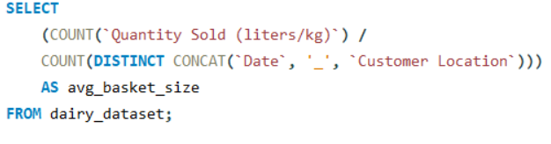
Question 13
What is the average basket size across all orders?
OUTPUT
SQL Code
INSIGHTS
🛒 Average Basket Size: 1.1 items per order

Slide 17
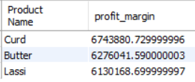
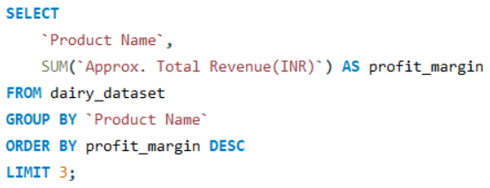
Product Analysis
Question 14
Which products have the highest profit margins?
OUTPUT
SQL Code
INSIGHTS
💸 Highest Profit Margin Products: Curd, Butter (based on total revenue)

Slide 18
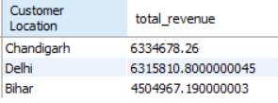
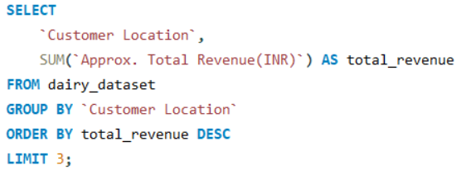
Inventory & Operational Metrics
Question 15
Which locations have the highest total revenue?
OUTPUT
SQL Code
INSIGHTS
🚛 Top Locations by Revenue: Chandigarh, Delhi, Bihar lead overall revenues

Slide 19
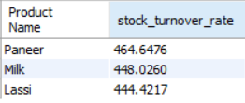
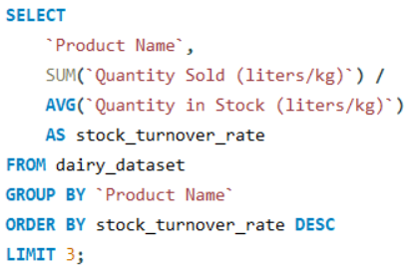
Question 16
Which products have the highest stock turnover rate?
OUTPUT
SQL Code
INSIGHTS
🔄 Highest Stock Turnover: Paneer, Milk, Lassi

Slide 20
Recommendations
✅ Focus inventory on high-turnover products (e.g., Milk, Yogurt)
🛆 Bundle popular pairs (Milk + Butter, Paneer + Yogurt)
🔄 Encourage repeat purchases through loyalty offers
⚠️ Reduce overstocking of slow-moving products

Slide 21




THANK YOU!
Joydip Karmakar
GitHub
Open to collaborations and feedbacks.

